Slide 1
Query Part

Slide 2
Class Diagram

Slide 3
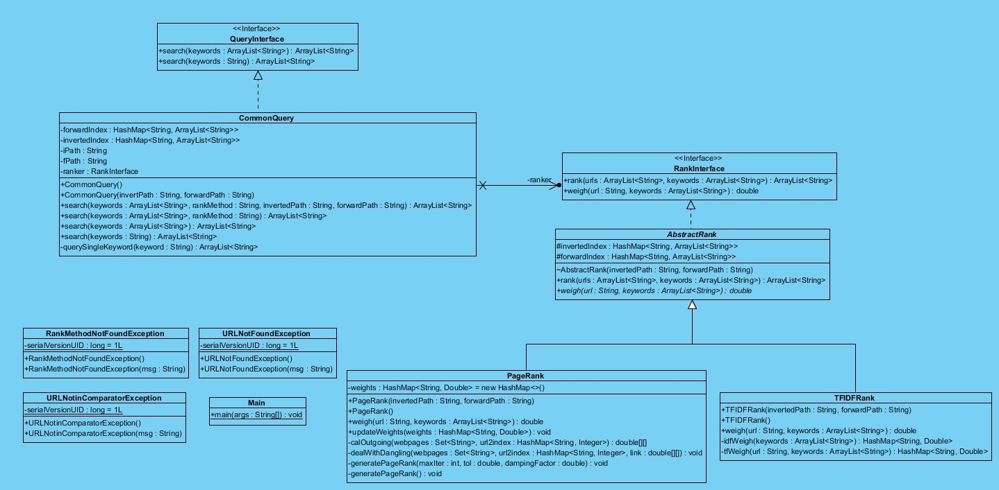

Slide 4
Pattern and Principle

Slide 5
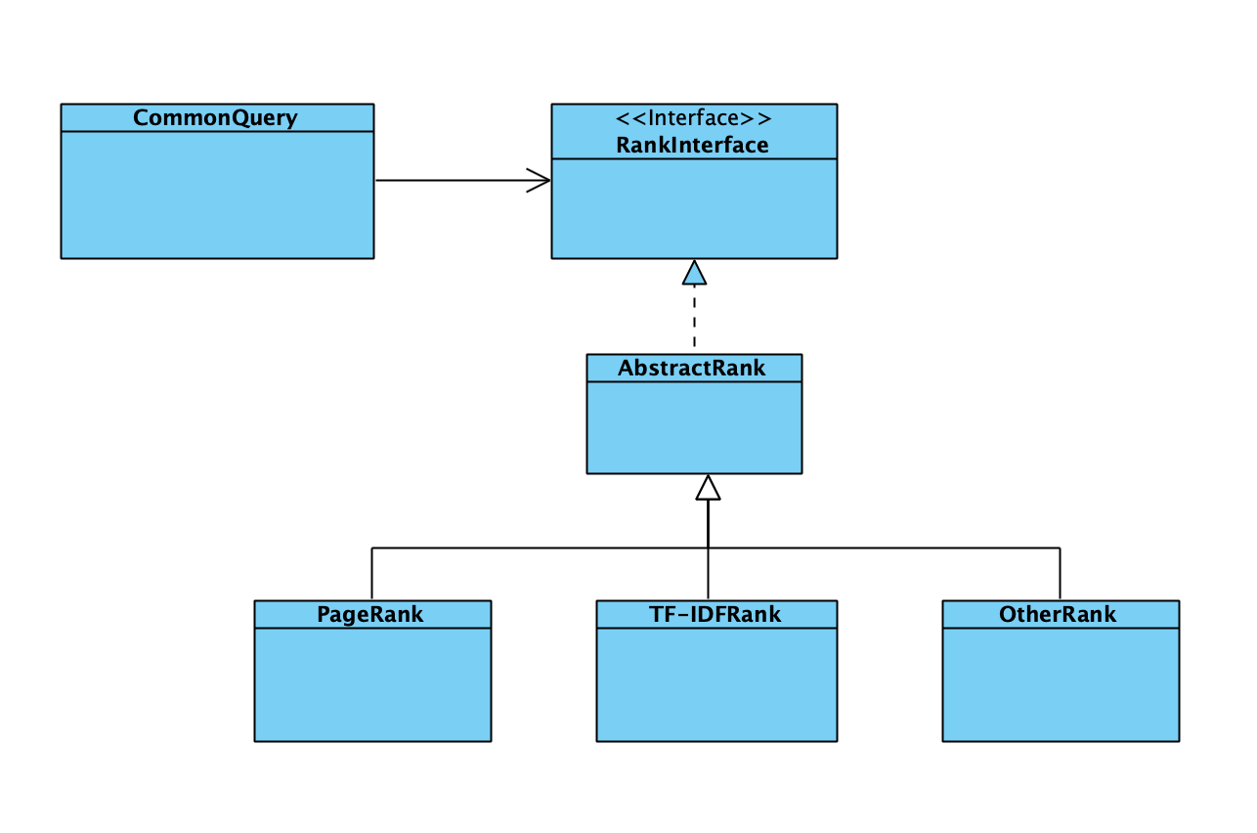
Open-Closed Principle + Strategy Pattern

Slide 6
Algorithm & Implement

Slide 7
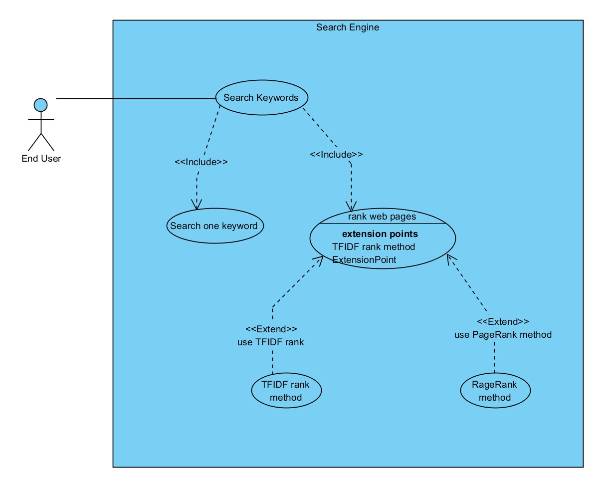

Slide 9
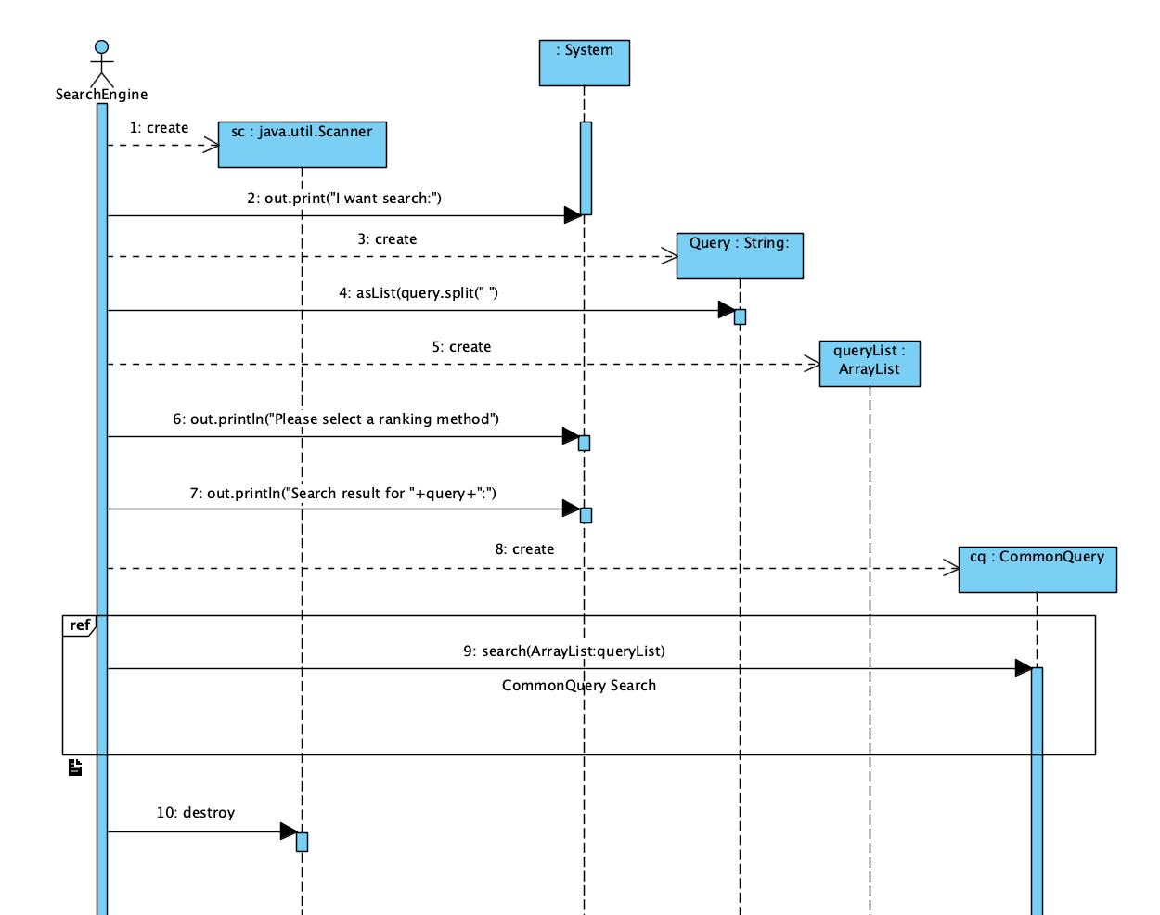

Slide 10
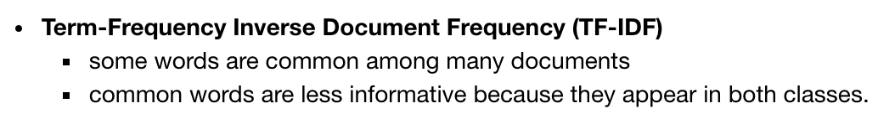
TF-IDF

Slide 11
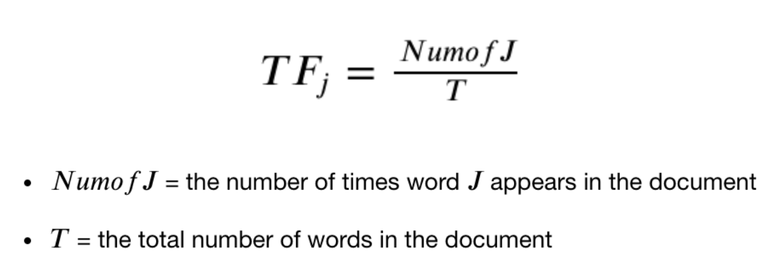
TF

Slide 12
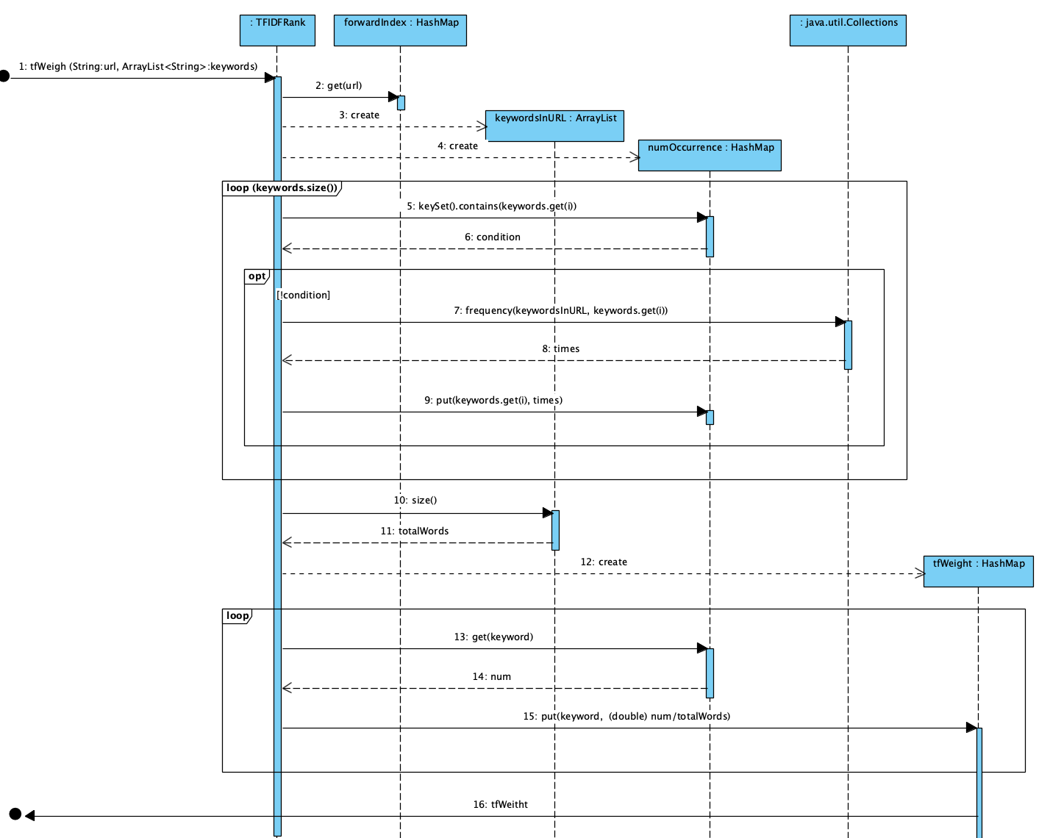

Slide 13
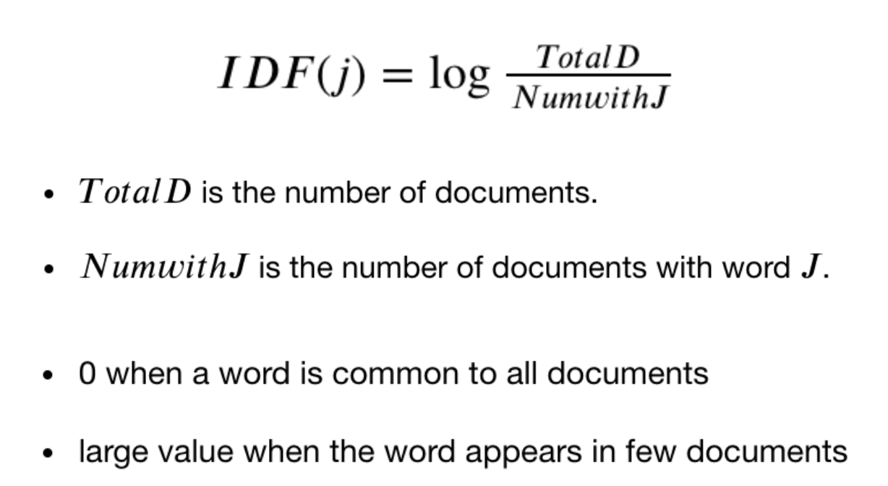
IDF Measure rarity of each word

Slide 14
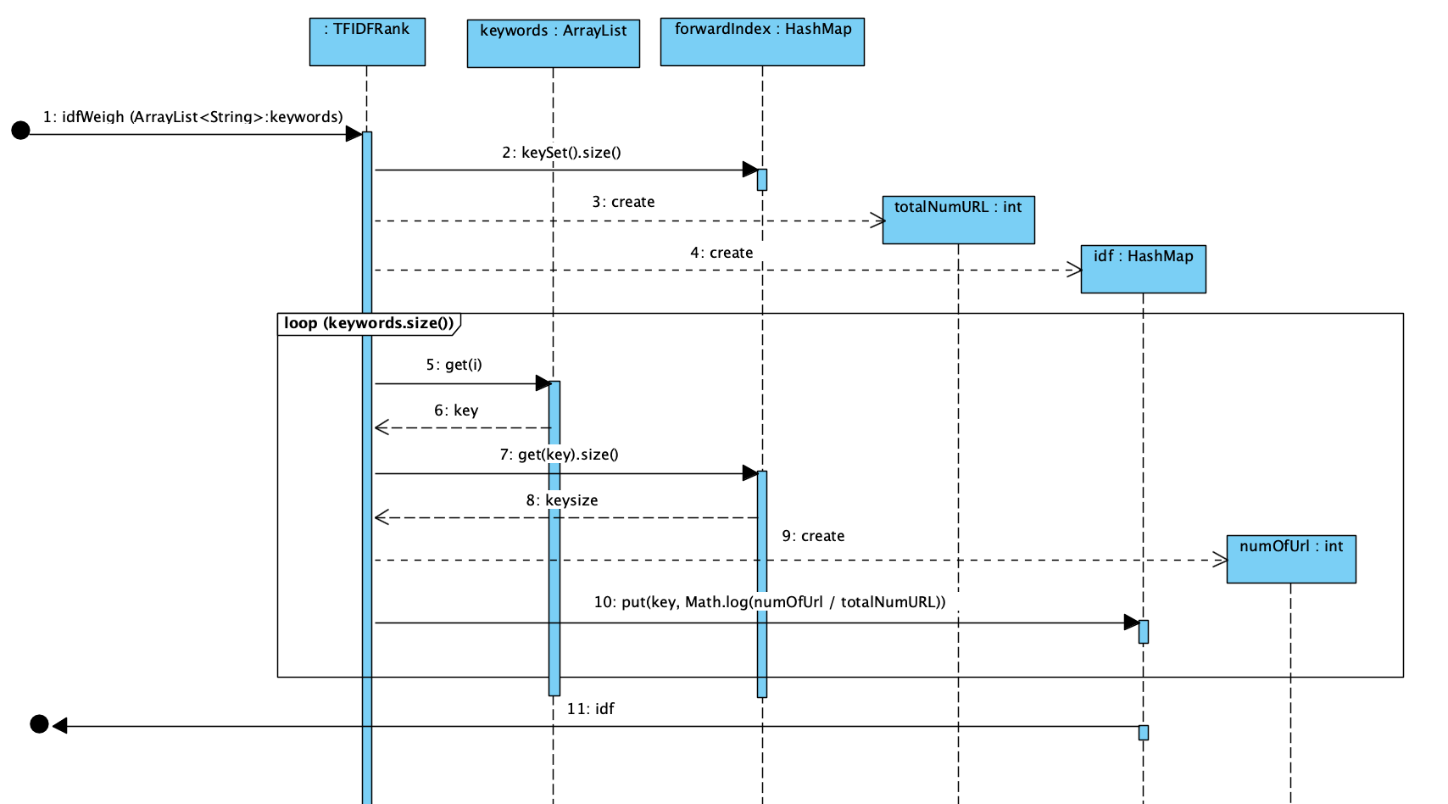

Slide 15
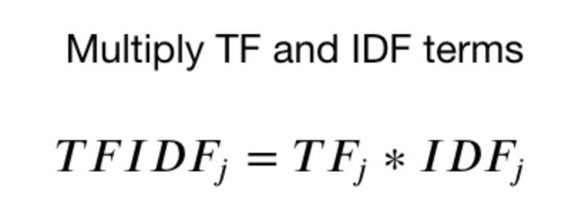
TF-IDF vector

Slide 16
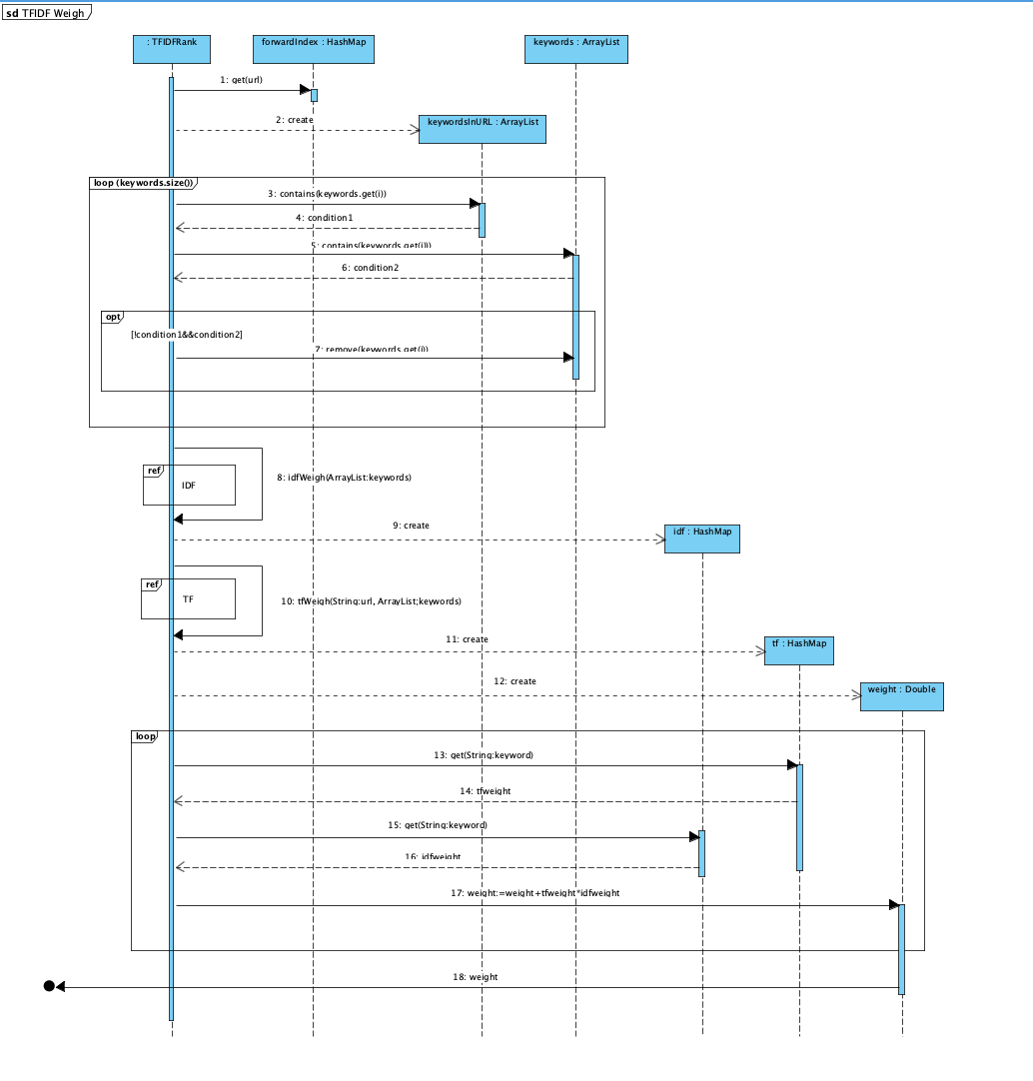
Sequence Diagram

Slide 17
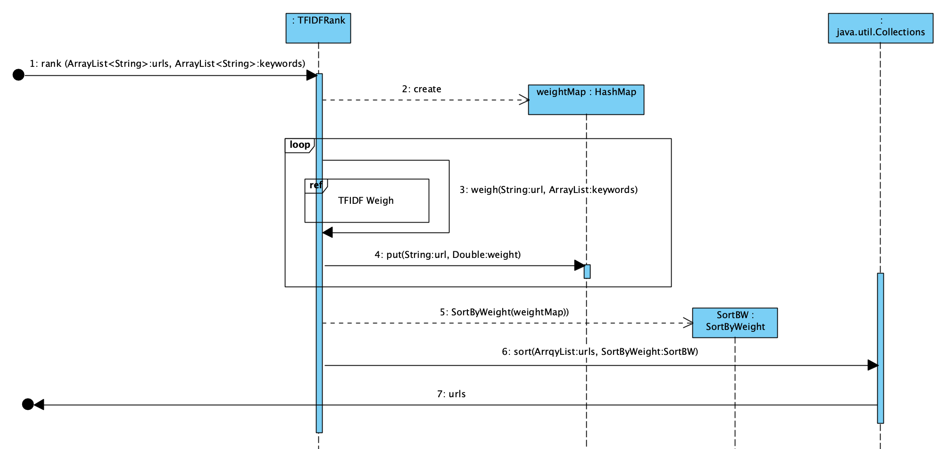

Slide 18
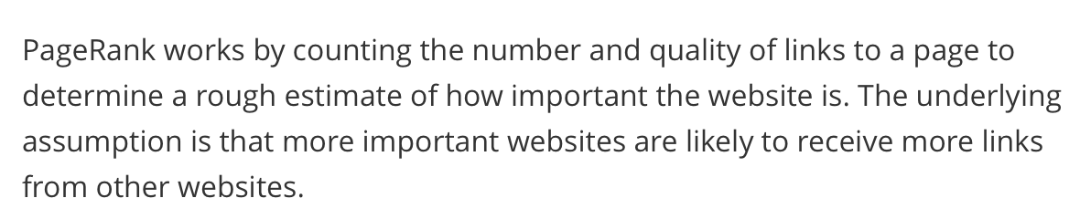
PageRank

Slide 19
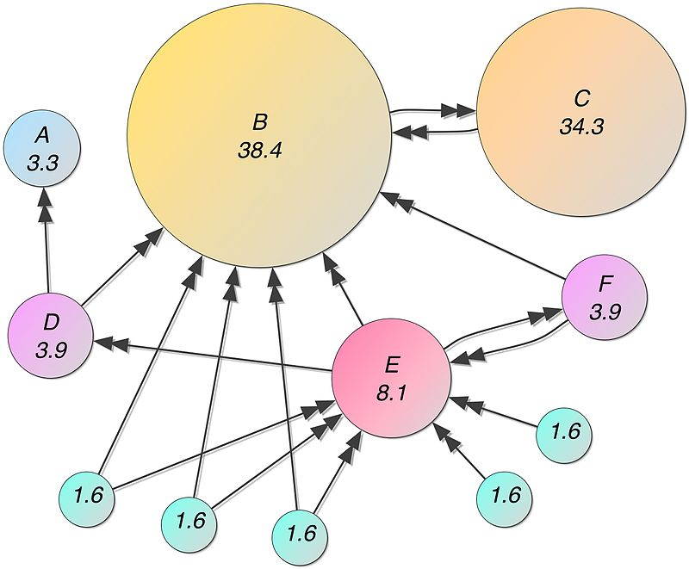

Slide 20
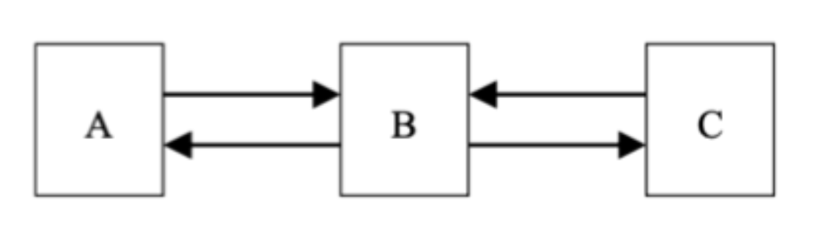

Slide 21
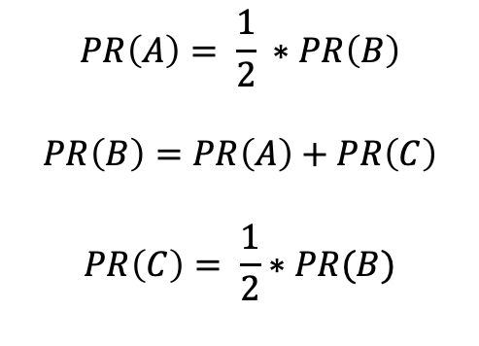
$$PR\left(A\right)= \frac{1}{2} ∗PR\left(B\right)$$
$$PR\left(B\right)=PR\left(A\right)+PR\left(C\right)$$
$$PR\left(C\right)= \frac{1}{2}∗PR(B)$$

Slide 22
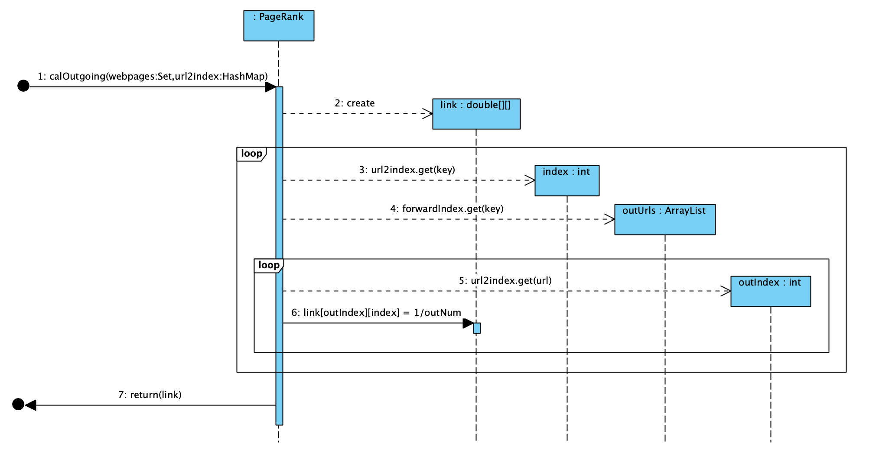

Slide 23
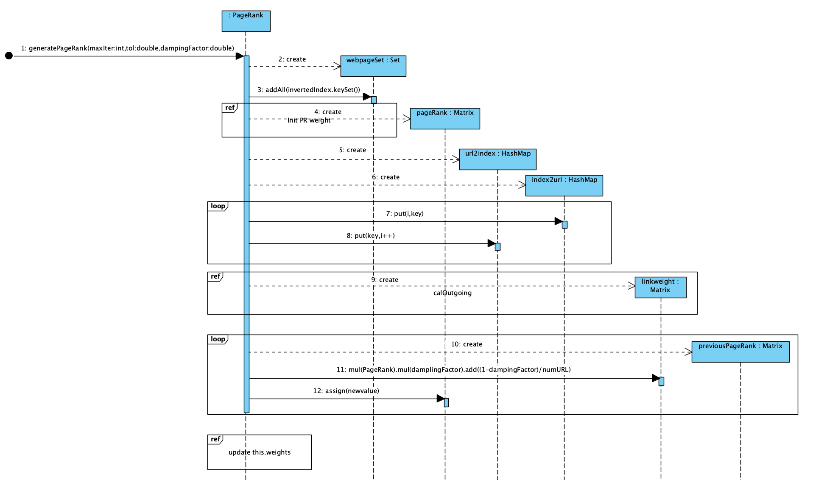

Slide 24


